Slide 1


Physics-Informed Neural Networks (PINNs)
Imri Aharoni, DSRC data scientist
HiAI 2025, University of Haifa AI Conference

Slide 2
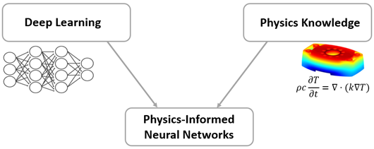
What are PINNs? Physics-Informed Neural Networks
PINNs are neural networks that embed physical laws directly into the learning process.
They enable models that:
Respect known physics even in data-scarce regimes
Combine data-driven learning with physics-based constraints
Produce solutions that are physically consistent, interpretable, and generalizable
Core Concept- Minimize a combined loss function:
Physics Loss: Penalizes residuals of the governing PDE
Data Loss: Penalizes error at known observations
Raissi, Perdikaris and Karniadakis 2019 - Physics-informed neural networks: A deep learning framework for solving forward and inverse problems involving nonlinear partial differential equations

Slide 3
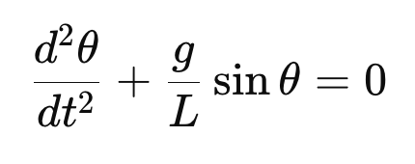
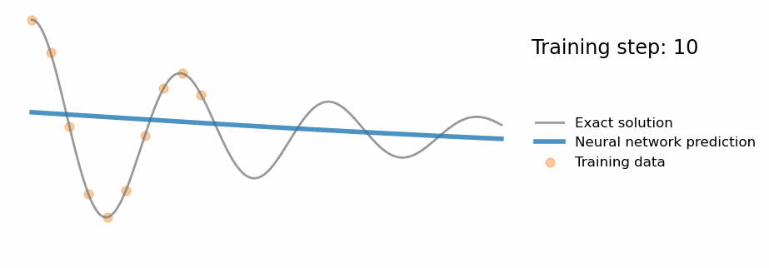
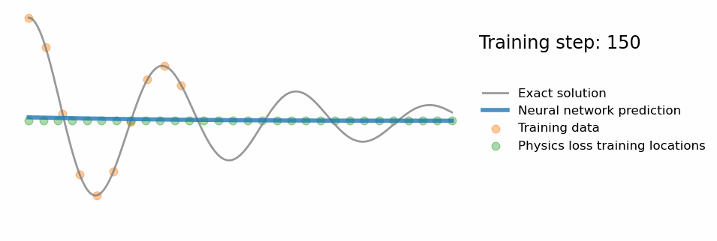

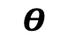
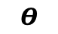
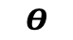


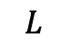
Pendulum Motion
Data-Driven Neural Network
Physics Informed Neural Network
$$Θ$$
$$L$$
Hidden Layers
Hidden Layers
X Input
y Pred
X Input
y Pred
$$Θ$$
PDE Residual
t
t
$$Θ$$
Physics Loss = PDE Residual
Data Loss= | $Θ$_{Pred} - $Θ$_{Real}|
Total Loss = Data Loss + Physics loss
$$Θ$$
$$Θ$$
t
t

Slide 4
What makes PINNs a powerful modeling framework?
Approximate solutions to complex physical system dynamics- PDEs, non-linear equation etc.
Solve inverse problems from limited data- such as estimating model parameters, initial states etc.
Training Data
(X , t)
PINN model
Approx Solution (U_{θ}​)
Estimate Physics Parameters
+
Full Solution (U_{θ}​)
Sparse Data
(X, t, U_{measured})
PINN model
Advantages Over Traditional Numerical Methods
Fast Inference– A trained PINN provides near-instantaneous predictions without the need for iterative numerical solvers
Robust to Experimental Data – Capable of integrating experimental data with physics constraints
Unified Framework – Can solve multi-physics and coupled PDE problems within a single model.
Mesh-Free Solution – PINNs provide continuous solutions without requiring a predefined grid.
Advantages Over Pure Data-Driven Models
Enhanced Generalization – Incorporates physical constraints, improving accuracy, stability, and reliability
Reduced Data Dependency – Leverages physics-based learning to compensate for sparse or noisy data
Improved Interpretability – Enables extraction of meaningful physical insights from model predictions.

Slide 5
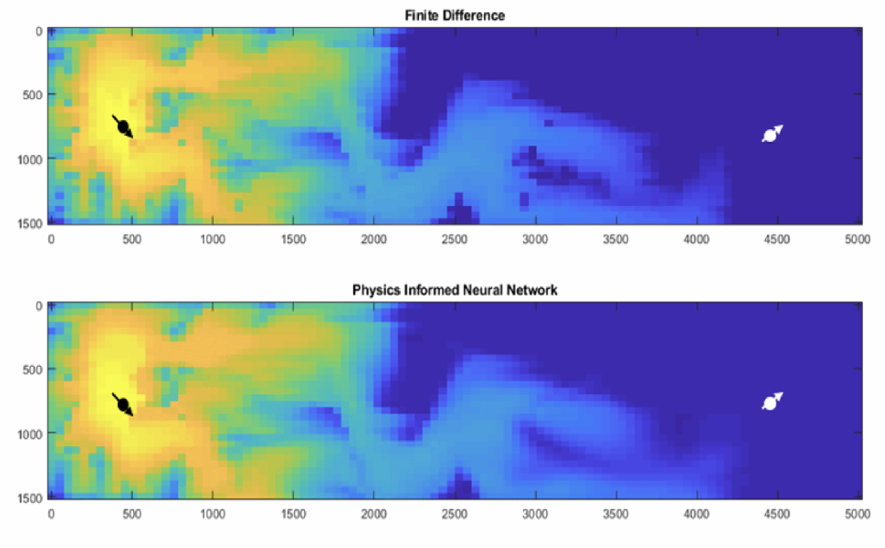
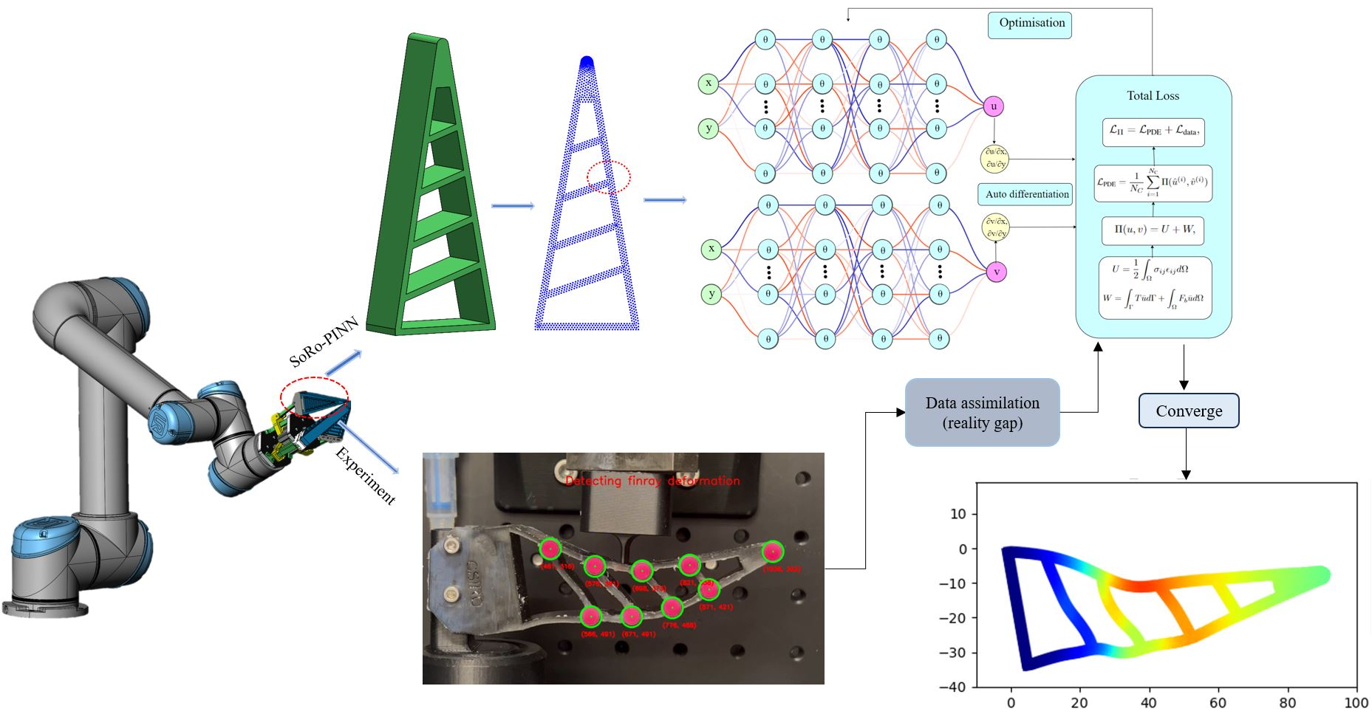
Real-World Applications of PINNs
Fluid dynamics
Modeling turbulence, aerodynamics, weather prediction from sparse experimental data
Handles irregular geometries and multi-physics problems better than traditional methods
“Using Physics-Informed Deep Learning for Flow and Transport in Porous Media
Fraces at al. by NVIDIA 2021.
Robotics
Accurate predictions of robot dynamics with minimal experimental data
Faster, more efficient simulations for adaptive control strategies
“PINN-Ray: A Physics-Informed Neural Network to Model Soft Robotic Fin Ray Fingers”
Wang at al. 2024.

Slide 6
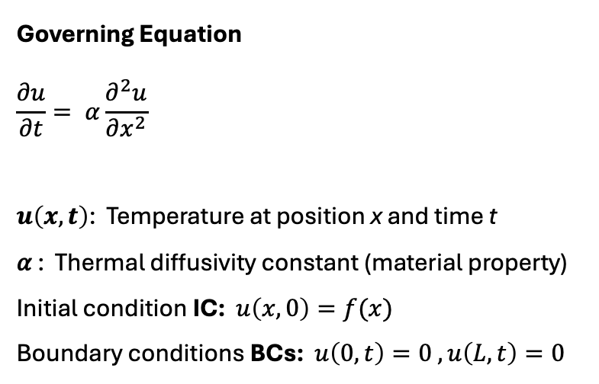
Example System – 1D Heat Equation
Temperature distribution in a one-dimensional metal rod over time
Governing Equation
$$\frac{∂u}{∂t}= α\frac{∂^{2}u}{∂x^{2}}$$
$u\left(x,t\right)$: Temperature at position x and time t
𝛼 : Thermal diffusivity constant (material property)
Initial condition IC: $u\left(x,0\right)=f(x)$
Boundary conditions BCs: $u\left(0,t\right)=0 , u\left(L,t\right)=0$
t = 100 sec
U = temperature ℃
x = 100 cm

Slide 7
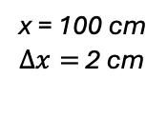
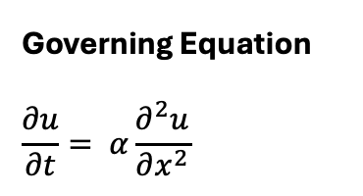
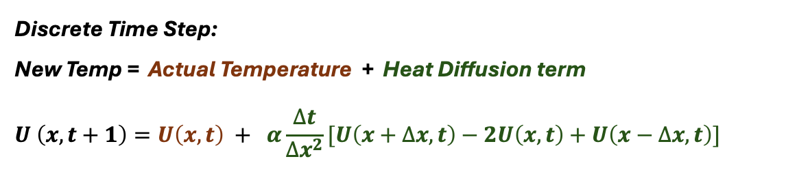
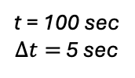
Traditional Numerical Modeling
Finite Difference Method
Divides the computational domain into a specified grid or mesh to systematically solve PDEs
Converts partial differential equations (PDEs) into algebraic equations using discretization
Approximates derivatives using finite differences on spatial and temporal grids
U = temperature C
t = 100 sec
$∆t=$ 5 sec
x = 100 cm
$∆x=$ 2 cm
Governing Equation
$$\frac{∂u}{∂t}= α\frac{∂^{2}u}{∂x^{2}}$$
Discrete Time Step:
New Temp = Actual Temperature + Heat Diffusion term
$$U \left(x, t+1\right)=U\left(x,t\right) + α\frac{∆t}{∆x^{2}}[U\left(x+∆x, t\right)−2U\left(x,t\right)+U\left(x−∆x,t\right)]$$

Slide 8
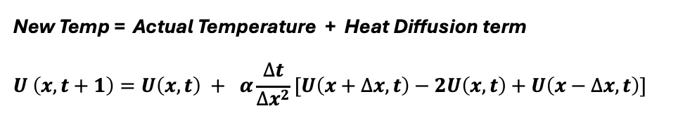
Traditional Numerical Modeling
Finite Difference Method
Divides the computational domain into a specified grid or mesh to systematically solve PDEs
Converts partial differential equations (PDEs) into algebraic equations using discretization
Approximates derivatives using finite differences on spatial and temporal grids
U = temperature C
t = 100 sec
$∆t=$ 5 sec
x = 100 cm
$∆x=$ 2 cm
New Temp = Actual Temperature + Heat Diffusion term
$$U \left(x, t+1\right)=U\left(x,t\right) + α\frac{∆t}{∆x^{2}}[U\left(x+∆x, t\right)−2U\left(x,t\right)+U\left(x−∆x,t\right)]$$
Key Limitations
Grid Dependency : Solution accuracy strongly depends on grid spacing, but finer resolution increases the computational demands
Numerical Stability : Limits the possible time step size as spatial grids become finer, thus increasing computational requirements
Computational Complexity
Increasing the resolution results in exponential growth in computational demands by a factor of * 2^{Dimention}
Difficulties in scaling- Becomes highly demanding with complex geometries and higher-dimensional problems

Slide 9
PINN Solution for 1D Heat Equation
Overcoming the critical limitations of numerical methods
Mesh-Free: Continuous Approximation Eliminates the need for predefined grid discretization
Automatic Differentiation: Overcoming numerical stability limitations allowing for flexible time step choice
Integration of Physics and Measurements: Seamlessly combines physical laws and limited data into the learning process.
t = 100 sec
U = temperature C
x = 100 cm
Core Strengths
Improved Scalability- Much more efficient handling of complex, higher-dimensional problems
Accuracy and Robustness- Consistent and reliable solutions under varying conditions and sparse data

Slide 10
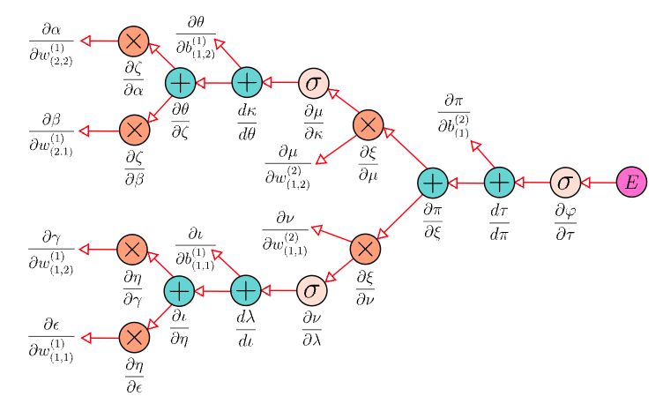
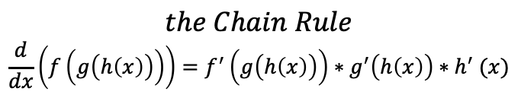
Automatic Differentiation (algorithmic differentiation)
A computational technique for evaluating derivatives of functions specified by computer programs
Avoids numerical approximation or symbolic representation of the derivatives
$$the Chain Rule$$
$$\frac{d}{dx}\left(f\left(g\left(h\left(x\right)\right)\right)\right)=f^{′}\left(g\left(h\left(x\right)\right)\right)∗g^{′}\left(h\left(x\right)\right){∗h}^{′}(x)$$
What AutoDiff it does? Computes derivatives using the chain rule:
Breaks complex functions into a sequence of basic operations (+, –, ×, ÷, exp, log, sin, cos, etc.)
Accumulates derivative values automatically during forward or backward passes
AutoDiff in Neural Networks
Core component in training neural networks through backpropagation algorithm:
Computes gradients (derivatives) needed for optimizing Weights to minimize the loss function
AutoDiff in PINNs
Computes the PDE derivatives required to evaluate the PDE residual term (Physics Loss)
Enables enforcement of physics constraints within the neural network training process
Provides stability and accuracy for complex PDE’s

Slide 11
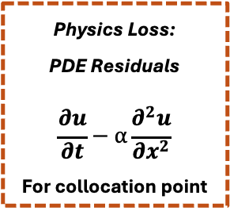
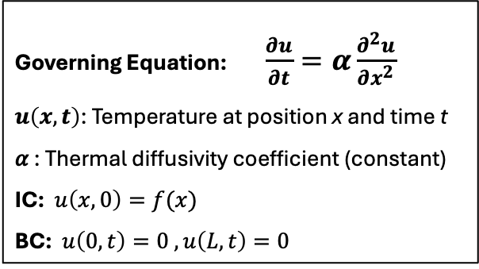
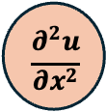
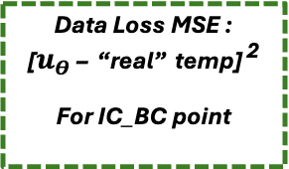

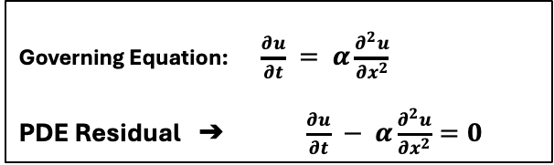
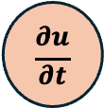
Basic PINN Structure and Components Training of forward solution
Governing Equation: $\frac{∂u}{∂t}=α\frac{∂^{2}u}{∂x^{2}}$
$u\left(x,t\right)$: Temperature at position x and time t
𝛼 : Thermal diffusivity coefficient (constant)
IC: $u\left(x,0\right)=f(x)$
BC: $u\left(0,t\right)=0 , u\left(L,t\right)=0$
Deep Neural Network
Automatic Differentiation
Input
Predicted Temperature
$$\frac{∂u}{∂t}$$
Governing Equation: $\frac{∂u}{∂t} = α\frac{∂^{2}u}{∂x^{2}}$
PDE Residual ➔ $\frac{∂u}{∂t} − α\frac{∂^{2}u}{∂x^{2}}=0$
x
Physics Loss:
PDE Residuals
$$\frac{∂u}{∂t}−α\frac{∂^{2}u}{∂x^{2}}$$
For collocation point
position
$$u_{Θ}$$
$$\frac{∂^{2}u}{∂x^{2}}$$
t
Data Loss MSE :
[$u_{Θ}$ – “real” temp] ²
For IC_BC point
time
Loss Function Components
PDE Residual Loss - Enforces governing PDE across the domain
IC/BC Loss- Enforces known initial/boundary values
NN Weights Optimization
Total Loss = PDE Loss + IC_BC Loss

Slide 12
PINN Training
Training Sets Construction
Set Data Loader
Neural Network Forward Pass
Automatic Differentiation
Optimization Loop
Collocation Points (Interior Domain):
Sampled at random (x, t) domain
No target value (u)
Used to compute PDE residuals
Loss Function Aggregation
X,T Collocation
Lₜₒₜₐₗ > ϵ
NN Layers
Total Loss =
𝛼 Physics Loss
+
𝛽 IC_BC Loss
+
𝛾 Data Loss
Update NN weights/biases using defined optimizer
PINN Derivatives: ∂u/∂t, ∂²u/∂x²
X,T
IC/BC
Boundary and Initial Condition Points:
Located on domain boundaries
Known target values (u)
Predict U
Calculate error:
| û - u |
X,T
Exp Data
Lₜₒₜₐₗ < ϵ
Output Final PINN Solution
Measurement Points (Optional):
Sparse Known (x, t) locations
Measured target value (u)
No time decency in standard PINN, point order is usually shuffled
Ensures that every update step sees a blend of physics and data constraints
Predicts û(x,t) for all points in the batch
Computes Loss for BC_IC points
Computes Data Loss for measurements points
Calculate Physics Loss for Collocation points
Measures how well PDE is satisfied
Sum all loss components into a single function
𝛼,𝛽,𝛾 are tunable, to balance the importance of physics vs. data constraints
A point can belong to more than one category, that means it contributes to more than one loss term.

Slide 13
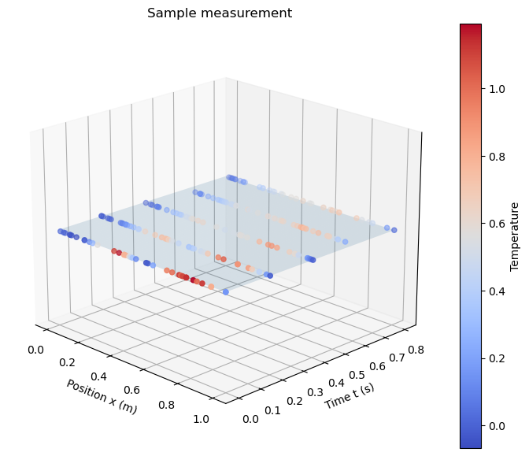
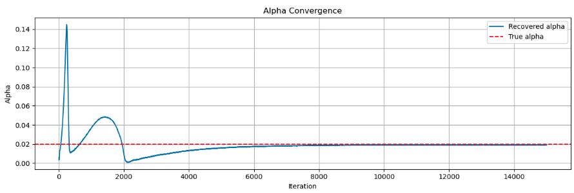
PINNs for Inverse Problems- Using measurements data
An inverse problem involves estimating unknown physical parameters, source terms, or system properties as well as the full field solution from indirect or sparse measurements
Examples include:
Estimating property coefficients in a differential equations
Inferring initial or boundary conditions
Reconstructing hidden source terms or external force
How PINNs Handle Inverse Problems:
The unknown parameters are defined as a trainable parameter in the neural network training process
Initial “guess” values are given to the tunable parameters
Handling of collocation points and BC / IC remains the same
The total loss becomes: Total Loss = PDE_Loss + IC_BC Loss + Exp_Data_Loss
Learning is driven by:
Enforcing the governing PDE constrains across the domain.
Fitting to sparse measurements (minimizing data loss) by tuning the physical parameters
Sample measurements (x,t) → u

Slide 14
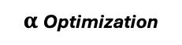
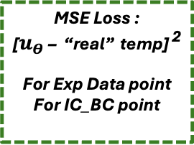
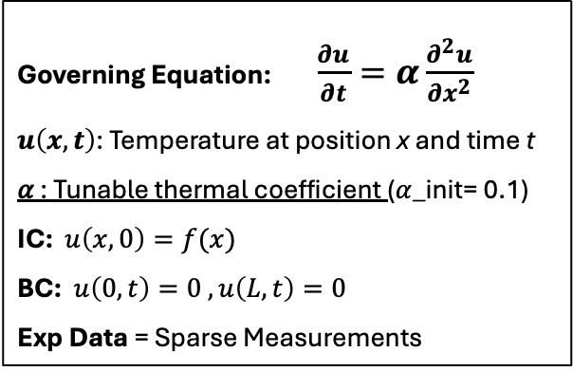
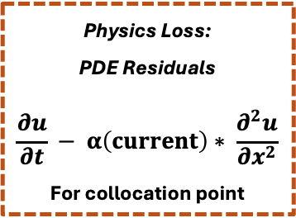
PINN Structure and Components Training of inverse solution
Governing Equation: $\frac{∂u}{∂t}=α\frac{∂^{2}u}{∂x^{2}}$
$u\left(x,t\right)$: Temperature at position x and time t
𝛼 : Tunable thermal coefficient ($α$_init= 0.1)
IC: $u\left(x,0\right)=f(x)$
BC: $u\left(0,t\right)=0 , u\left(L,t\right)=0$
Exp Data = Sparse Measurements
Deep Neural Network
Automatic Differentiation
Input
Predicted Temperature
$$\frac{∂u}{∂t}$$
Physics Loss:
PDE Residuals
$$\frac{∂u}{∂t} − α\left(current\right)∗ \frac{∂^{2}u}{∂x^{2}}$$
For collocation point
x
position
$$u_{Θ}$$
$$\frac{∂^{2}u}{∂x^{2}}$$
t
MSE Loss :
[$u_{Θ}$ – “real” temp] ²
For Exp Data point
For IC_BC point
time
Loss Function Components
PDE Residual Loss - Enforces governing PDE across the domain
IC/BC Loss- Enforces known initial/boundary values
Data Loss- Fits model to measured data by adjusting tunable parameters
Total Loss =
PDE Loss +
IC_BC Loss +
Exp Data Loss
NN Weights Optimization
$α$Optimization

Slide 15
Practical Challenges
Convergence Challenges
PINNs can suffer from slow convergence or instability, especially for poorly scaled , High-order PDEs.
Loss Term Balancing
Choosing weights for each term in the total loss is non-trivial, dynamic re-weighting is common.
Normalization is crucial
Scaling inputs and PDE terms improves stability and makes loss terms more interperable.
Sampling Strategy and Collocation Points
The number and distribution of interior, BC/IC and observation points impacts the model training performance
Training Dynamics and Optimization
Optimizer choice and learning rate strategies based on data and physics error

Slide 16

Hybrid and Extended PINN Architectures
To address challenges related to scale, domain complexity, and model interpretability advanced PINN architectures are constantly beeing developed, for example:
XPINNs: divide domain and apply local PINNs with interface continuity
FNOs: use Fourier transforms to operate in frequency domain
SINDy-PINNs: discover symbolic PDE terms during training
Promising directions of machine learning for partial differential equations
Steven L. Brunton & J. Nathan Kutz , Nature Computational Science (2024)

Slide 17
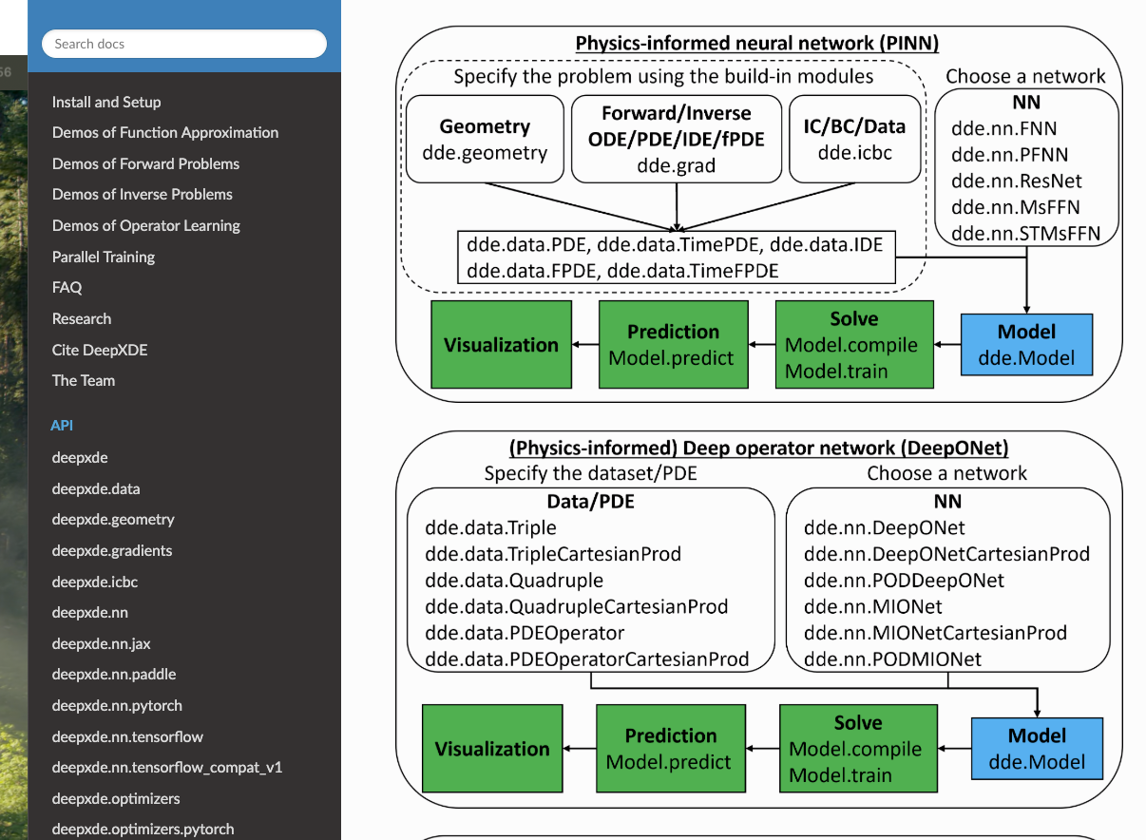

DeepXDE
A library for scientific machine learning and physics-informed learning
Developed by Lu Lu and George Karniadakis
https://www.youtube.com/playlist?list=PLM7DTyYjZGuLYDLV9g7AqkEatySe-lAqG
https://deepxde.readthedocs.io/en/latest/index.html

Slide 18
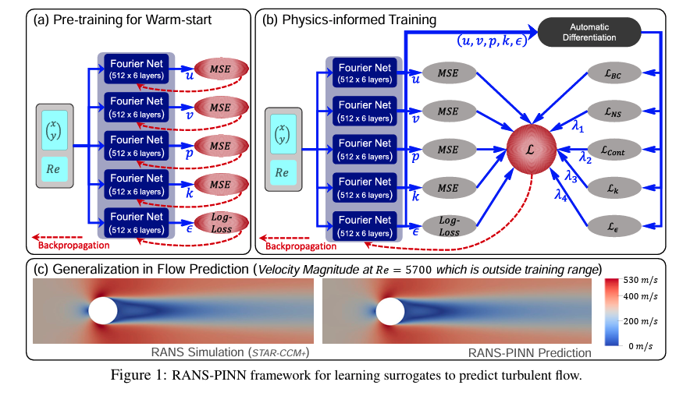
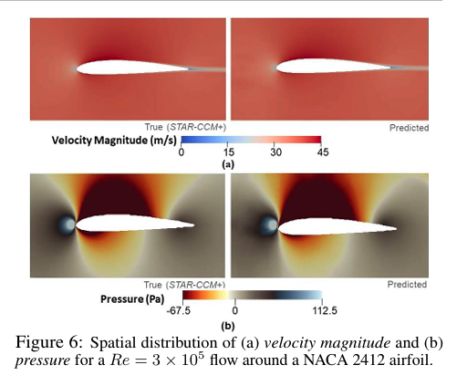
RANS-PINN based Simulation Surrogates for Predicting Turbulent Flows Ghosh et al., 2023
Quickly predict turbulent fluid dynamics (air / water) flow around different shapes without running costly CFD simulations
Prediction- Maps of flow speed, pressure, and two turbulence metrics (k–ε) over 2‑D or 3‑D geometries such as cylinders, wings etc.
Input Data- Gridded geometry of the object plus inlet wind profile and boundary conditions taken from conventional CFD runs
Physics Basis- Respects the Reynolds‑Averaged Navier–Stokes (RANS) equations with a standard turbulence closure.
Architecture: A system of 5 Fourier Neural Operator (FNO) , each predicting one variable (u, v, p, k, ε) The FNO networks transforms data with space-time values and learns spatial patterns on the frequency domain, efficiently capturing complex patterns like turbulence.
Phys‑Learning: Combines supervised learning with PDE residuals optimization.
First fits on simulated training data
Then fine‑tunes while reducing the fluid‑equation residual.

Slide 19
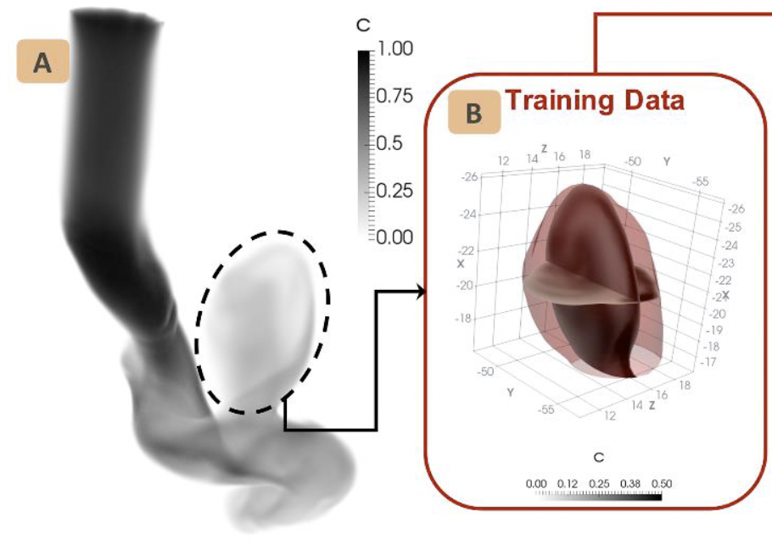
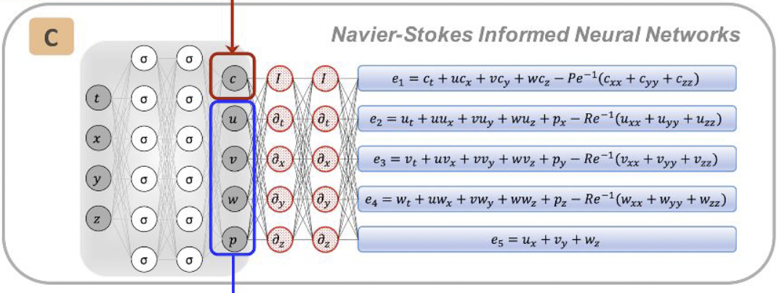
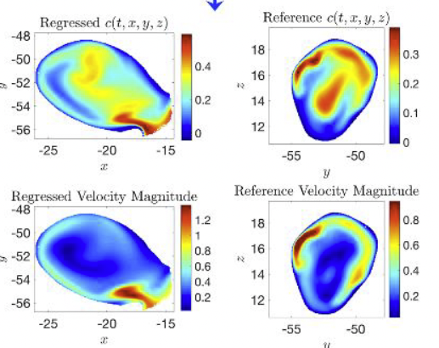
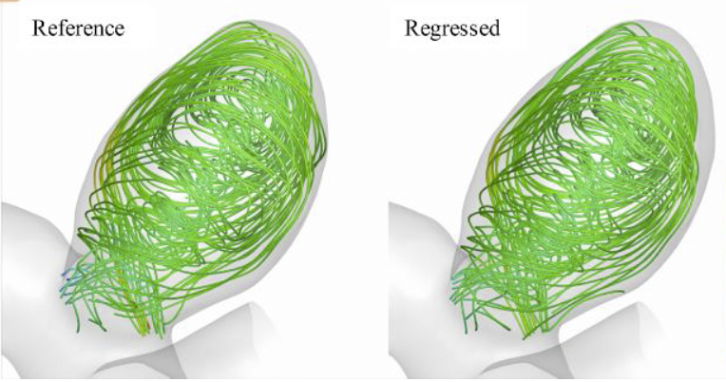
Hidden fluid mechanics: Learning velocity and pressure fields from flow flow visualizations Raissi, Yazdani & Karniadakis, 2020
Hemodynamics in brain aneurysm
Recover the full 3‑D flow field in complex geometry using only flow‑visualization image and videos
Prediction- 3D flow maps, velocity and pressure components throughout the complex geometry flow volume
Input- Video frames showing tracer intensity (dye/smoke flow tracers). pixel’s brightness is converted to a scalar concentration value and tagged with its 3‑D position
Physics Basis- Standard fluid‑motion equations (Navier–Stokes) coupled with an advection– diffusion equation for the chemical tracer.
Architecture- Fully connected NN that takes a space‑time coordinate (x, y, z, t) and returns the dye concentration C, pressure P, and 3D velocity components (u,v,w)
Phys‑Learning
- Imposes the Navier–Stokes PDE residuals on the flow field results through loss function.
- Matches the predicted dye concentrations to the video data for minimizing data loss.

Slide 20
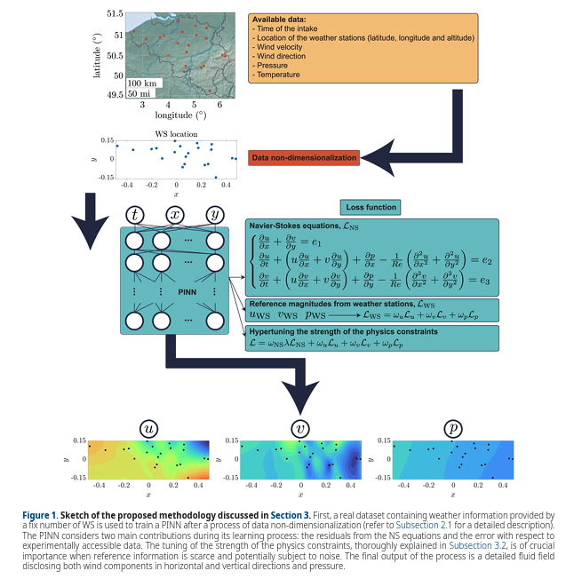
Physics-Informed Neural Networks for High-Resolution Weather Reconstruction from Sparse Weather Stations Moreno Soto et al. , 2024
Reconstruct high resolution wind and pressure fields over large regions, using sparse measurements from few local weather stations
Prediction- High-resolution, spatially continuous maps of wind components and atmospheric pressure over the modeled area
Input- Time-stamped weather station data including wind speed, direction, pressure, and location
Physics Basis- Governing fluid flow equations (Navier–Stokes) that enforce consistency in mass and momentum conservation across the atmospheric domain
Architecture- Fully connected neural network mapping spatial–temporal inputs to wind components and pressure value
Phys-Learning- Minimizing Data-Loss & PDE residuals through wights optimization.
Data loss- matching predictions vs weather station measurements
PDE loss- The calculated Navier stokes PDE residuals

Slide 21
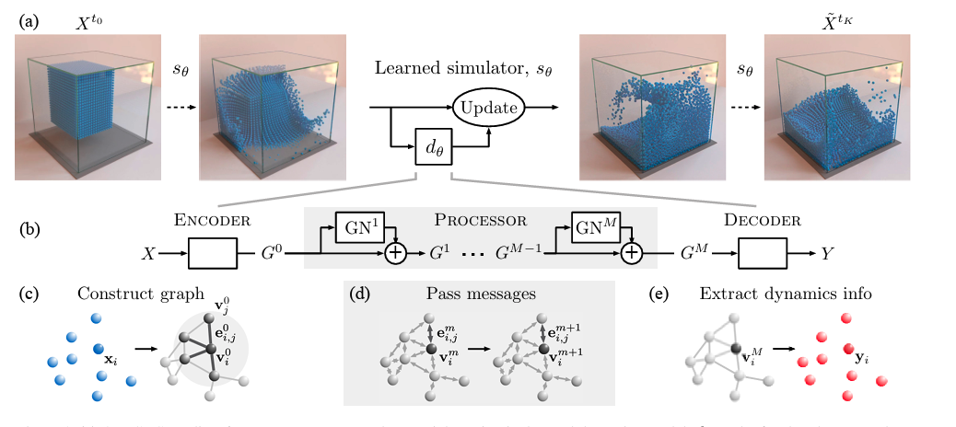
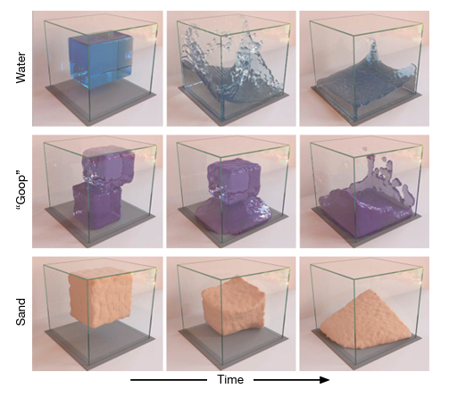
Learning to Simulate Complex Physics with Graph Networks Sanchez‑Gonzalez et al., 2020
A fast single surrogate model that can simulate fluids, solids, and rigid bodies interacting with one another
Prediction- Next‑step particle positions, velocities, and accelerations, enabling rolled forward simulation
Input- A set of particles properties: position, velocity, mass, type (fluid, sand, rigid, etc.) usually exported from high‑fidelity physics simulators
Physics Basis- No explicit analytic equations; instead, physical behaviors (locality, pairwise forces) emerge from how particles communicate on the GNN
Architecture: Encode → Process → Decode Graph Network. - Encode: Converts particle attributes into latent node and edge features. - Process: Runs multiple rounds of message passing to immediate neighbors - Decode: Maps the final latent state of each particle to its new physical attributes
Phys-Learning- Purely data-driven, The model minimizes one‑step prediction error on simulator trajectories.
neighbor-to-neighbor message passing naturally enforces locality , while aggregating equal‑and‑opposite messages imposes momentum conservation.

Slide 22
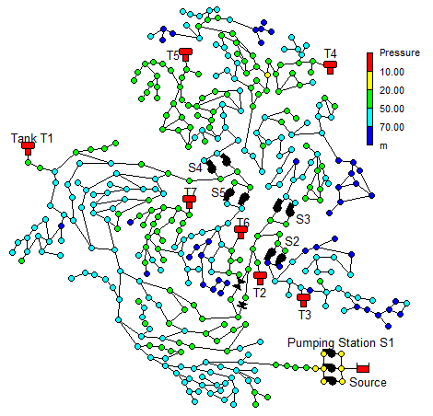
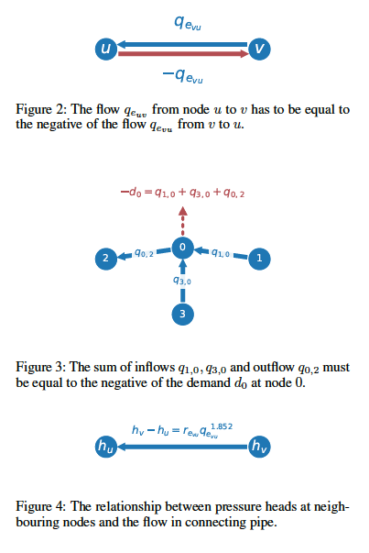
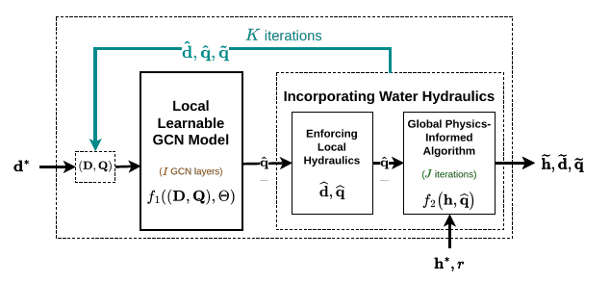
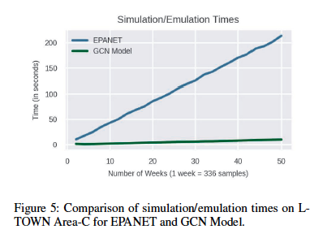
Physics‑Informed Graph Neural Networks for Water Distribution Systems Ashraf et al., 2024
Mass conservation
Estimate the hydraulic state of large drinking‑water networks in real time
Prediction- Pressure at every junction and flow in every pipe at each time step
Input Data- Network layout (nodes, links), pipe properties, temporal demand profiles, and a few pressure sensor readings
Physics Basis- Preserve ‘Mass conservation’ inflow = outflow + demand, & ‘Energy conservation’ - links pipe flow to pressure drop in each junction
Architecture- Graph convolutional neural
network (GCN) to encode and train on specific network topology, followed by physics informed algorithm to enforce the governing hydraulic formulas.
Phys‑Learning- Fully unsupervised, based on physical
principles only, no measurement data. training minimizes the mismatch between the GCN predictions flows and the physics‑refined flows/heads.
Energy conservation

Slide 23
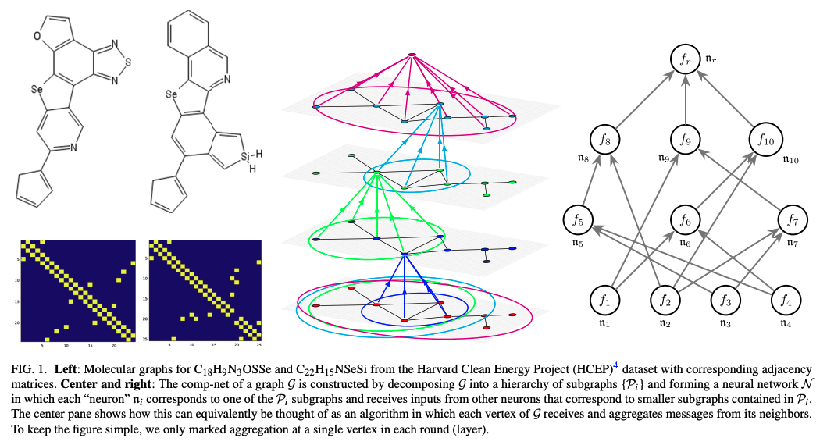
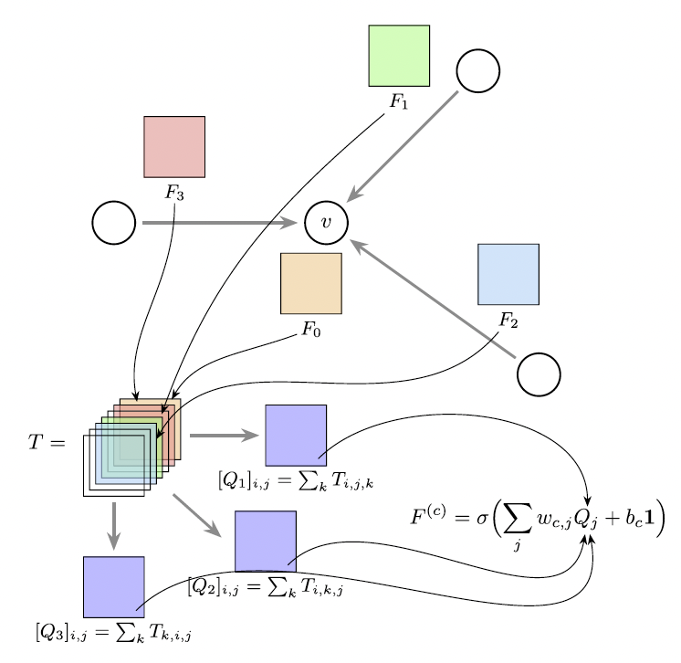
Predicting Molecular Properties with Covariant Compositional Networks Hy et al., 2018
Rapidly estimate quantum‑level molecular properties across vast chemical libraries
Prediction- Electronic‑structure properties such as atomization energy, formation enthalpy, dipole moment, and fundamental vibrational frequencies
Input- Molecular graph (atom types and 3‑D coordinates) extracted from datasets like QM9
Physics Basis- Encodes fundamental molecular symmetries (rotation and permutation of identical atoms) so predictions obey quantum‑mechanics symmetry constraints
Architecture- Hierarchical graph neural network, with covariant tensor messages passing that preserve symmetry
Phys‑Learning - Minimizes data errors against reference values. No explicit equation residuals are required; the network’s built‑in covariant operation naturally enforce the symmetry physics.

Slide 24
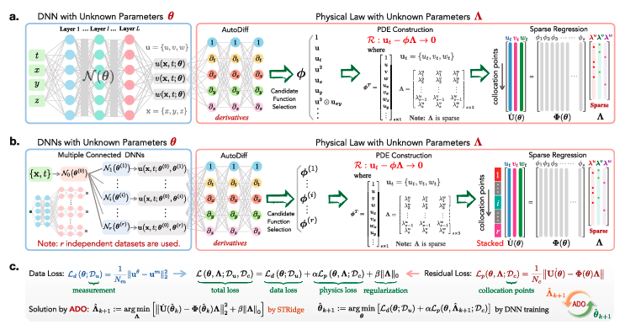
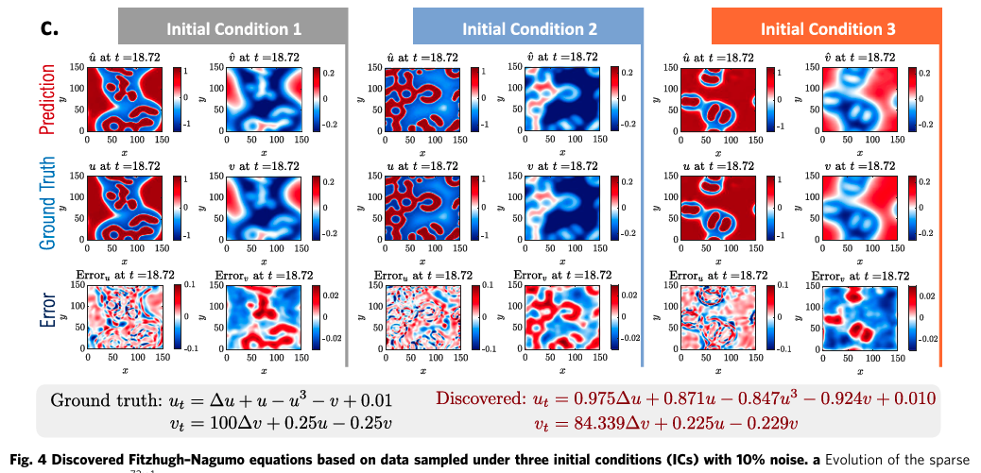
Physics-Informed Learning of Governing Equations from Scarce Data Chen, Liu & Sun, 2021
Recover the closed‑form partial differential equation that best describes a dynamical system from limited and noisy measurements
Prediction- (1) A readable PDE with estimated coefficients; (2) A neural model that solves the system’s full space‑time field
Input- Sparse and noisy measurements of field variables recorded over space and time under different scenarios
Physics- Assumes the true dynamics can be written as a linear combination of candidate terms from a predefined library of temporal and spatial derivatives, nonlinear products, etc.
Architecture- A shared neural network first learns a coarse representation of the system. Using automatic differentiation, it computes all the candidate terms at each point. A lightweight sparse‑regression block then keeps only the few terms required for the governing equation
Phys‑Learning - Training alternates between (1) tuning the network to match the data and lower the PDE residual of the current equation, and (2) rerunning sparse regression to drop terms that add little value. This back‑and‑forth converges to a concise PDE that explains the data while remaining interpretable.

Slide 25
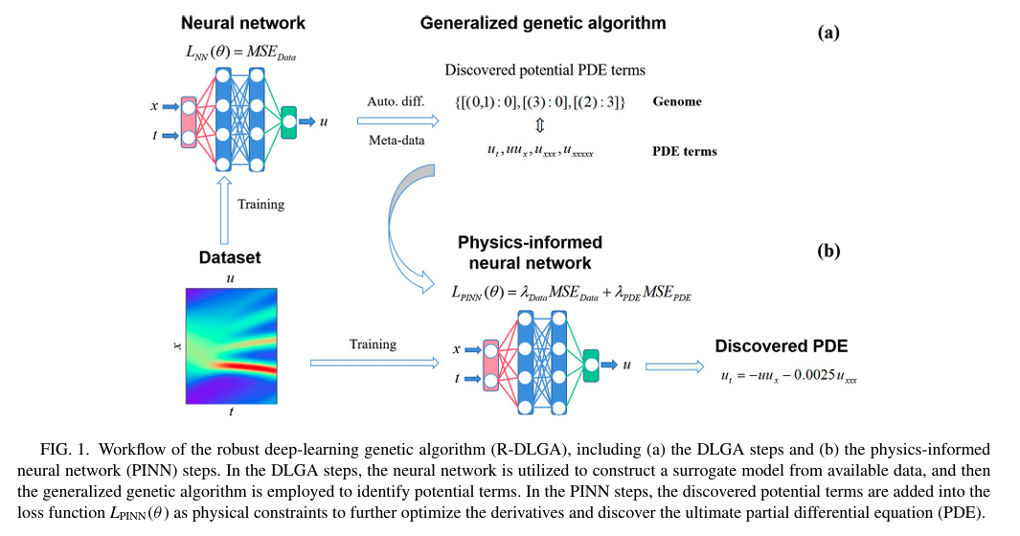
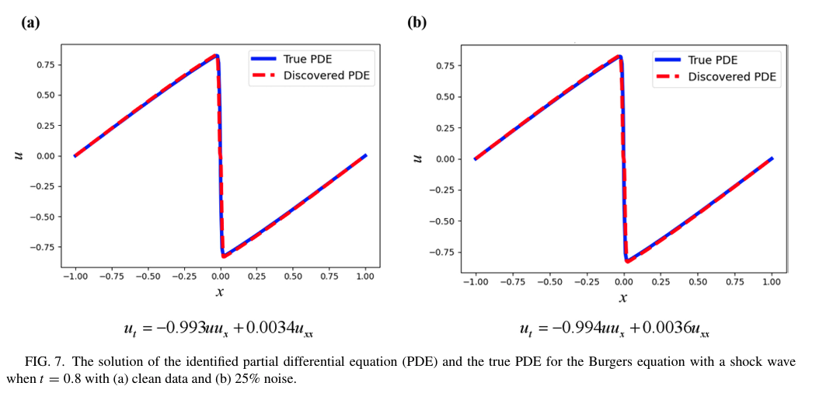

Robust discovery of partial differential equations in complex situations Xu and Zhang, 2021
Automatically discover the governing equation behind sparse, noisy, and possibly shock‑dominated data
Prediction: A symbolic partial‑differential equation with estimated coefficients & full domain solution
Input Data: Sparse measurements of how the system physical field evolves over space and time
Physics: Not known in advance—the algorithm learns the governing equation directly from the data
Architecture: Genetic algorithm proposes candidate equation terms; a PINN refines and ranks them
Phys‑Learning: Uses residuals of candidate equations as soft constraints during network training to evaluate plausibility.

Slide 26


Data‐Driven Equation Discovery of Ocean Mesoscale Closures Laure Zanna1,2 and Thomas Bolton2
Find simple, explainable formulas that describe how small-scale ocean motions (eddies) affect larger-scale climate model simulations that cannot directly resolve them.
Prediction: Compact formulas that capture small‑scale momentum and heat transfer effects, together with a neural network that rapidly computes these corrections.
Input Data: High‑resolution sea‑surface fields (currents, temperature) produced by ocean-atmosphere circulation model
Physics Basis: Ensures conservation of momentum and vorticity by expressing closures in divergence form.
Architecture: Sparse Bayesian regression selects a few key terms; those terms feed a physics‑constrained fully‑connected CNN.
Phys‑Learning: Trains the CNN while penalising violations of the conservation‑form residuals.

Slide 27

Thank you vey much!!
Class Materials:
Visit our website at: https://dsrc.haifa.ac.il/?playlist=1d7a133&video=c6e22b5
For any question you're welcome to contact me at:
Imri.aharoni@gmail.com

Slide 28

Forward Physics-Informed Neural Networks for Catalytic CO₂ Methanation in Isothermal Fixed-Bed Reactors (Ngo & Lim, 2023)
Problem: Provide an efficient surrogate model for simulating gas-phase chemical reactions inside a reactor under varying conditions.
Outputs: Species molar flow rates (CO₂, H₂, CH₄, H₂O) predicted at any axial position along the reactor.
Input: Axial position and operating temperature (pressure and inlet composition are fixed).
Physics: Chemical reaction dynamics described by steady-state 1-D mass balance equations with defined reaction kinetics.
Architecture: A feedforward neural network that takes in the position along the reactor and the operating temperature and predicts the chemical species flow rates at that point.
Phys-Learning: Training is guided entirely by physical laws of mass conservation and reaction kinetics, without reliance on labeled experimental data.

Slide 29


A Physics-Embedded Deep Learning Framework for Cloth Simulation
Zhao, 2024
Develop a fast and physically plausible method for simulating cloth dynamics suitable for real-time applications
Prediction- Time-evolved predictions of cloth node positions and velocities.
Input- Current positions and velocities of cloth mesh nodes, along with external forces such as collisions or pressure.
Physics Base- Cloth behavior is governed by mass–spring mechanics, incorporating elastic, damping, and pressure-based forces.
Architecture: CNN-based framework using a 13-point stencil to extract local geometric features and predict physical responses.
Phys-Learning- The model architecture reflects physical principles, and training incorporates force-balance consistency to ensure dynamic realism

Slide 30


Enhancing Arterial Blood Flow Simulations through Physics-Informed Neural Networks
Replace slow Computational Fluid Dynamics (CFD) simulations for patient‑specific arterial hemodynamics
Outputs: Velocity & pressure fields in 2‑D/3‑D vessels.
Physics: Incompressible Navier–Stokes (ρ(u·∇)u + ∇p − µ∇²u = 0, ∇·u = 0).
Architecture: Space–time XPINN (multiple MLP sub‑nets + interface continuity).
Phys‑Learning: Enforces Navier–Stokes residual together with boundary and continuity constraints in the loss.
Input: CT‑derived geometry, inlet flow waveform, outlet pressure/traction

Slide 31



Physics-informed Neural Networks with Fourier Features for Seismic Wavefield Simulation in Time-Domain Nonsmooth Complex Media
In order to assess the accuracy of the proposed method for solving the wave equation, the results of the finite difference method (FDM) are used as reference data

Slide 32

Physics-informed neural network for seismic wave inversion in layered semi-infinite domain

Slide 33


Physics-Informed Neural Networks for Low Reynolds Number Flows over Cylinder

Slide 34


Learning rigid-body simulators over implicit shapes for large-scale scenes and vision

Slide 35



Data-driven discovery of partial differential equations

Slide 36




